Slide 1
Television
By Aaron Shields and Michael Payne

Slide 2
Today we are learning about Technology Transfer in Televisions.

Slide 3
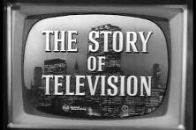
Lets start with the Genealogy of the Product
The Mechanical TV was invented in the late 19th Century (1875-1885)
Philo Taylor Farnsworth invented the Mechanical TV
It was a black and white picture.
It consisted of small selection of channels and low quality picture.

Slide 4
Now for Technology Transfer…

Slide 5
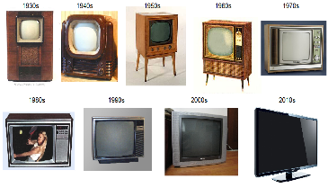
A Series of Innovations
-Electronic Television: Invented in 1897, black and white picture, connected to power outlet.
-Colour Television: Invented in20th Century, colourful picture, connected to power outlet.
-Digital Television: Invented in the 1950’s, very colourful picture, good image quality, HD, many channels
-Flat Screen

Slide 6
Advertising in Technology Transfer
-You can market this product very easily, because 96.7 percent of American Households have T.V’s
-As soon as new ones come out they will be bought
-On the newer T.V’s you can access social media and internet, newer T.V’s are always talked about on the internet and social media.
-Which makes people want to buy newer versions.

Slide 7
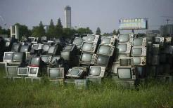
The Goals of the Company in Technology Transfer
-My beliefs align with the mission and vision of the company.
-Because certain TV’s, with high lead content in CRTs and the rapid diffusion of new flat-panel display technologies, some of which (LCDs) use lamps which contain mercury, there is growing concern about electronic waste from discarded televisions. -Related occupational health concerns can affect people greatly and put them at a serious risk.

Slide 8
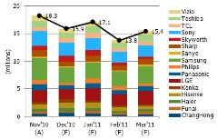
The Economy in Technology Transfer
-T.V’s are always in the Fiscal state in order to buy this item, because they earn lots of money for the Economy. -Newer versions are always coming out, and entertain people.
-T.V’s are not necessary/needed for success in life.
-Because they were originally made for entertainment and you don’t necessarily need entertainment for your life.
-But in some cases such as jails, and CCTV you will need T.V’s in order to maintain security purposes.

Slide 9
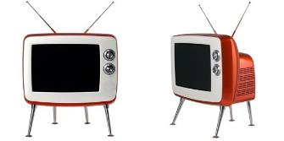
The Fads in Technology Transfer
-T.V’s have always been in style, since the first one hit the market. -They have been used for many purposes such as security watch, entertainment, and informing others.
-I think T.V companies have not crested at the moment. Because companies are expanding and are coming out (innovation) with newer models of the T.V

Slide 10
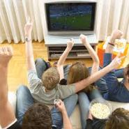
Social In Technology Transfer
My friends will not judge me for having a T.V because it’s a common item, lots of people have them, and they are in fashion.

Slide 11
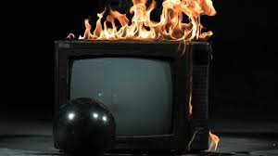
“The Next Step” for Televisions
T.V’s might already be completely advanced to the maximum.
But T.V’s can effect our environment, people, etc.
Some big steps for T.V companies that they should look at are Environmental, Political, and Economic side of things.
-Economic: affordable price
-Political: regulations and rules
-Environmental: how the products materials affect its surrounding environment.

Slide 12
And now for the Design part of Technology Transfer…

Slide 13
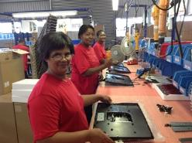
Economic in the Design Section of Technology Transfer
-The amount of money varies from creating this product, since there are newer/older, bigger/smaller, and more/lower quality of T.V’s.
-Retailers have about 20% margin. Manufacturers usually lose money..., but do give them 1-5% margin.

Slide 14
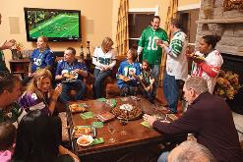
Political in the Design Section of Technology Transfer
-In order to make a T.V there are no regulations, except form watching highly toxic chemical intake to make the T.V. Also it must contain all of the essential parts to a T.V in order for it to work.
-I don’t think anyone has been ever mad that the T.V has been made because it has changed/revolutionized the world.

Slide 15
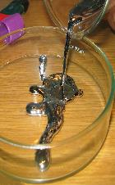
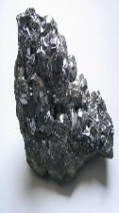
-You can create the T.V with the most positive impact possible by, sending it out on emails, T.V channels, social media, and on certain websites that have good deals on for authentic goods/items.
-Also you could do a grand opening at a store or just put it up for a really good price.
-There are certain TV’s that contain harmful chemicals. Such as some T.V’s can contain Mercury and Lead. With both can make your brain swell and cause harmful diseases.
Environmental In The Design Section Of Technology Transfer

Slide 16
THANKS FOR WATCHING!

